Slide 1

Explorative Analysis of Physical Health Status of citizens of USA
Exploratory Data Analysis Course Project
Team 4
Roll No. | Name | SRN
519 | PavanKumar | 01FE21BCS093
515 | Sachin .B | 01FE21BCS079
516 | Rajat B | 01FE21BCS082
501 | Kashiram o | 01FE21BCS006
Under the guidance of :
Dr. P. G. Sunitha Hiremath

Slide 2
Contents:
1. Introduction
2. Problem statement and objectives
3. Data collection
4. Data description
5. Data preprocessing
[1] Data inspection
[2] Data cleaning
6. Data Analysis

Slide 3
Introduction:
The dataset contains information related to various health conditions, behaviors, and risk factors, along with demographic and geographic details. It is a comprehensive collection of health-related data, making it a valuable resource for analyzing and understanding health trends, patterns, and disparities across different locations, periods, and demographic groups.
This dataset aims to provide insights into the prevalence and variations of various health conditions, behaviors, and risk factors across different locations and demographic groups. It allows researchers, policymakers, and public health professionals to identify patterns, disparities, and trends in health outcomes, helping them make informed decisions and interventions to improve public health and well-being.

Slide 4
Problem statement:
To Analyze the physical health status of citizens of USA based upon parameters like physical activity behavior, obesity weight status and fruits and vegetables consumption.
Objectives:
The main goal of exploratory analysis is to understand and explore the physical health status of people in the USA..
Understanding potential factors that may influence physical health outcomes, such as lifestyle habits, access to healthcare, and socioeconomic status.
Exploring how physical health varies across different demographic groups like age, gender, ethnicity, education, and income.

Slide 5
Data collection:
We have collected the data from: https://data.gov
This data set contains 33 attributes and 88630 rows
Data description:
This dataset includes data on adult's diet, physical activity, and weight status of individuals of several places taken from Behavioral Risk Factor Surveillance System.
This data is further divided according to different cities the people live in and it is categorized based on the physical health , obesity and weight status.
Data contains record from 2011-2021.

Slide 6
Attribute information:
Year Start : Year in which the survey started.
Year End : Year in which the survey ended.
LocationAbbr : short form of the name of a place.
Eg- Guam-GU
LocationDesc : Name of the place.
Data source : Behavioral Risk Factor Surveillance System.
Class : description of the health issues suffering by the people.
eg : obesity and weight status
Question : questions for us to categorize the data.
eg: 1)Percent of adults aged 18 years and older who have obesity
2)Percent of adults who engage in no leisure-time physical activity
Data value: The percentage value according to the question.
Sample size : the total number of people in the survey by Behavioral Risk Factor Surveillance System.
Age: age group of the people in the survey.
Gender: citizens belonging to different gender.

Slide 7
Attribute information:
Income : income of the people where the survey is taken place
Nationality : the people categorized during a survey according to latin_American , American ,Asian etc
Stratification : to group the people according to their nationality
GeoLocation : altitude and longitude of a particular location
classId : Alias name of particular class
eg : PA- Physical activity ,OWS -Obesity / Weight Status
Low_Confidence_Limit : Highest and lowest number in confidence interval
High_Confidence_Limit :The number at Upper and lower end of confidence interval

Slide 8
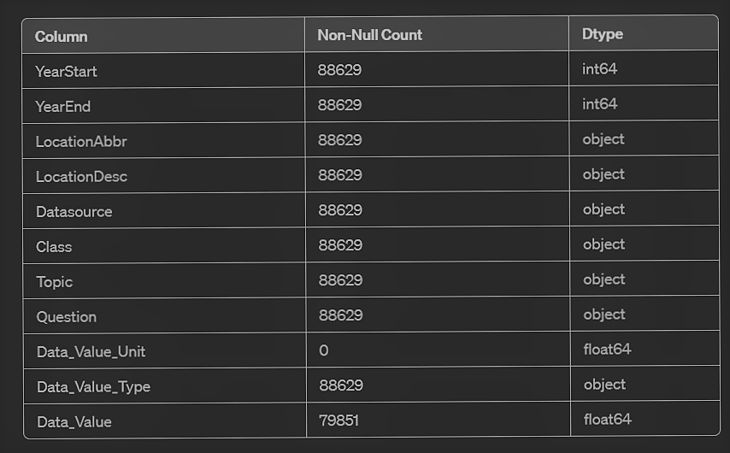
Data preprocessing
[1] Data Inspection
Total no of rows and column (88629, 33)
Information about the Data Frame

Slide 9
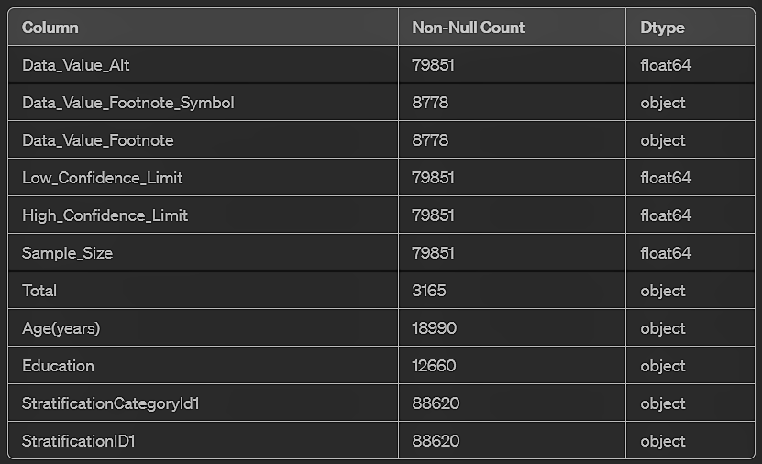
Contd:

Slide 10
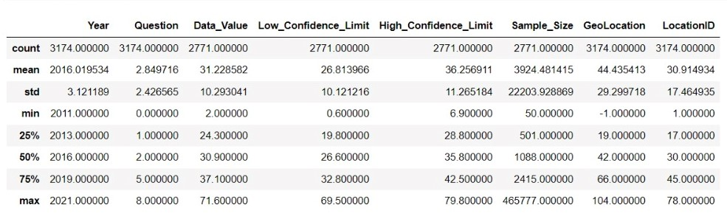
NUMERICAL DATA DISTRIBUTION

Slide 11
[2] Data cleaning
There are 14 attributes with NAN values
      Data_Value_Unit 100.000000
      Data_Value 9.904207
      Data_Value_Alt 9.904207
      Data_Value_Footnote_Symbol 90.095793
      Data_Value_Footnote 90.095793
      Low_Confidence_Limit 9.904207
      High_Confidence_Limit 9.904207
      Sample_Size 9.904207
      Total 96.428934
      Age(years) 78.573605
      Education 85.715736
      Gender 92.857868
      Income 75.002539
      Race/Ethnicity 71.431473
      GeoLocation 1.863950

Slide 12
Duplicate value count attribute-wise:
YearStart: 88618
LocationAbbr: 88574
LocationDesc: 88574
Datasource: 88628
Class: 88626
Topic: 88626
Question: 88620
Data_Value: 87933
Low_Confidence_Limit: 87962
High_Confidence_Limit : 87868
Sample_Size: 79048
GeoLocation: 88523
ClassID: 88626
LocationID: 88574

Slide 13
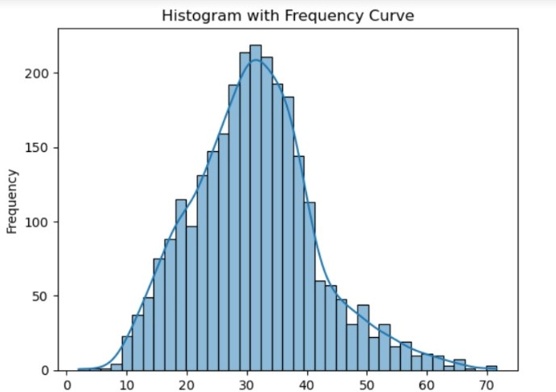
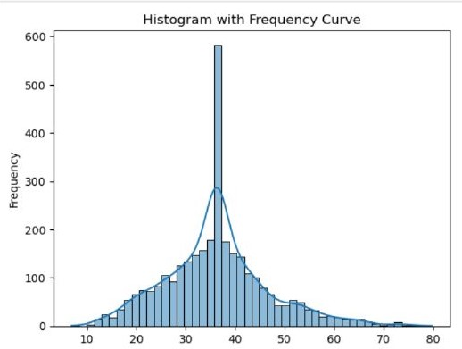
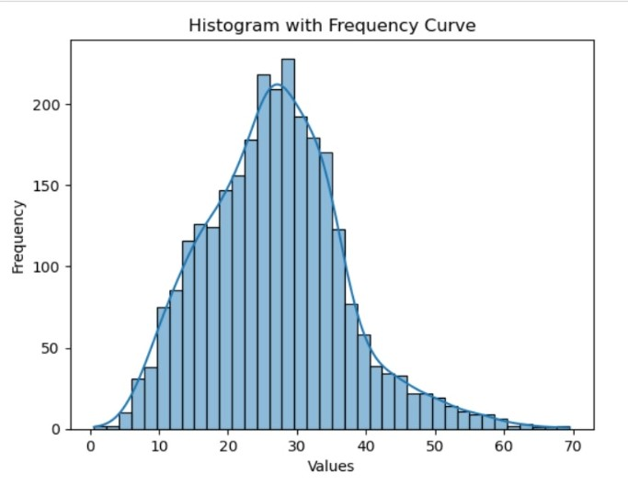
DISTRIBUTION OF DATA WITH RESPECTIVE THE ATTRIBUTES
Data value
Low_confidence_limit
High_confidence_limit
The Attributes are normally distributed hence we replace NAN values by mean.

Slide 14
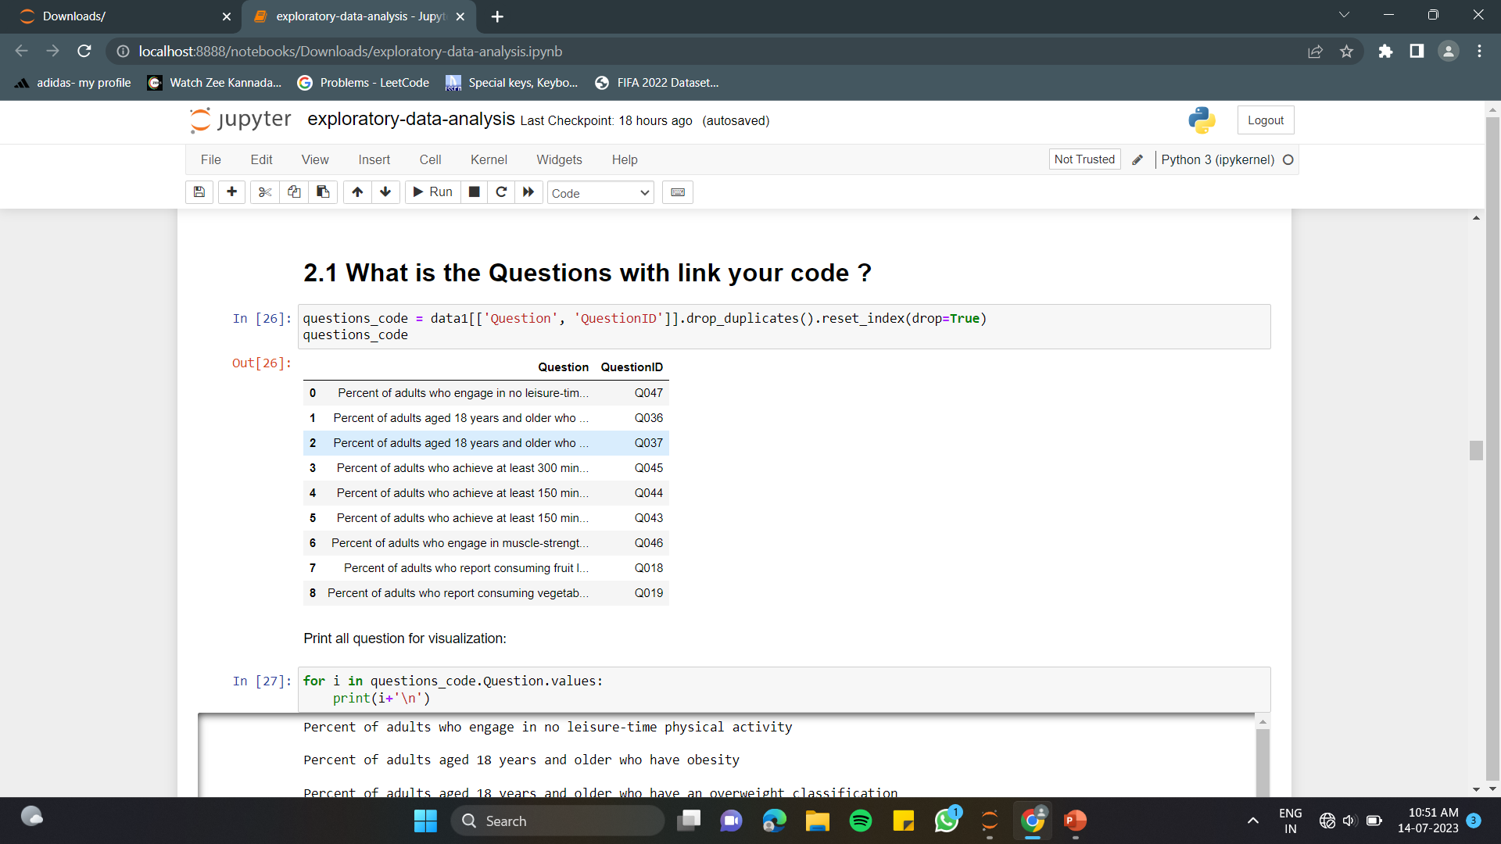
After deleting the attributes with Nan values and redundant tuples our dataset is reduced to 27 attributes and 3174 tuples.
We have used mean to replace the Nan values when the data is normally distributed.
Questions asked by the survey:

Slide 15
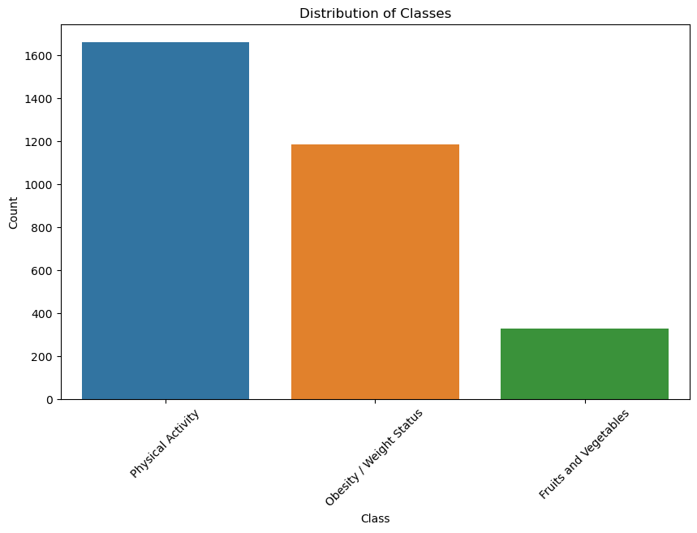
Data Analysis
Which class among physical activity, Obesity / Weight Status, Fruits and Vegetables – Behavior has the highest count of questions asked?
Inference: Most of the questions asked by Behavioural Risk Factor Surveillance system were related to Physical activity behaviour.

Slide 16
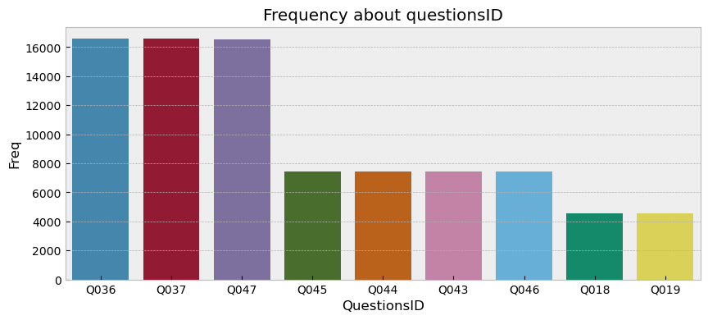
Most frequently asked Questions
Q036 16577 Q037 16577 Q047 16549 Q045 7449 Q044 7449 Q043 7449 Q046 7449 Q018 4565 Q019 4565
The number of questions asked by Behavioral Risk Factor Surveillance System in survey conducted

Slide 17
The most frequently asked questions :
Q036 - 'Percent of adults aged 18 years and older who have obesity'.
Q037 - 'Percent of adults aged 18 years and older who have an overweight classification'.
Q047 - 'Percent of adults who engage in no leisure-time physical activity'.
Inference:
The less frequently asked questions:
Q018 - 'Percent of adults who report consuming vegetables less than one time daily'
Q019 - 'Percent of adults who report consuming fruit less than one time daily'

Slide 18
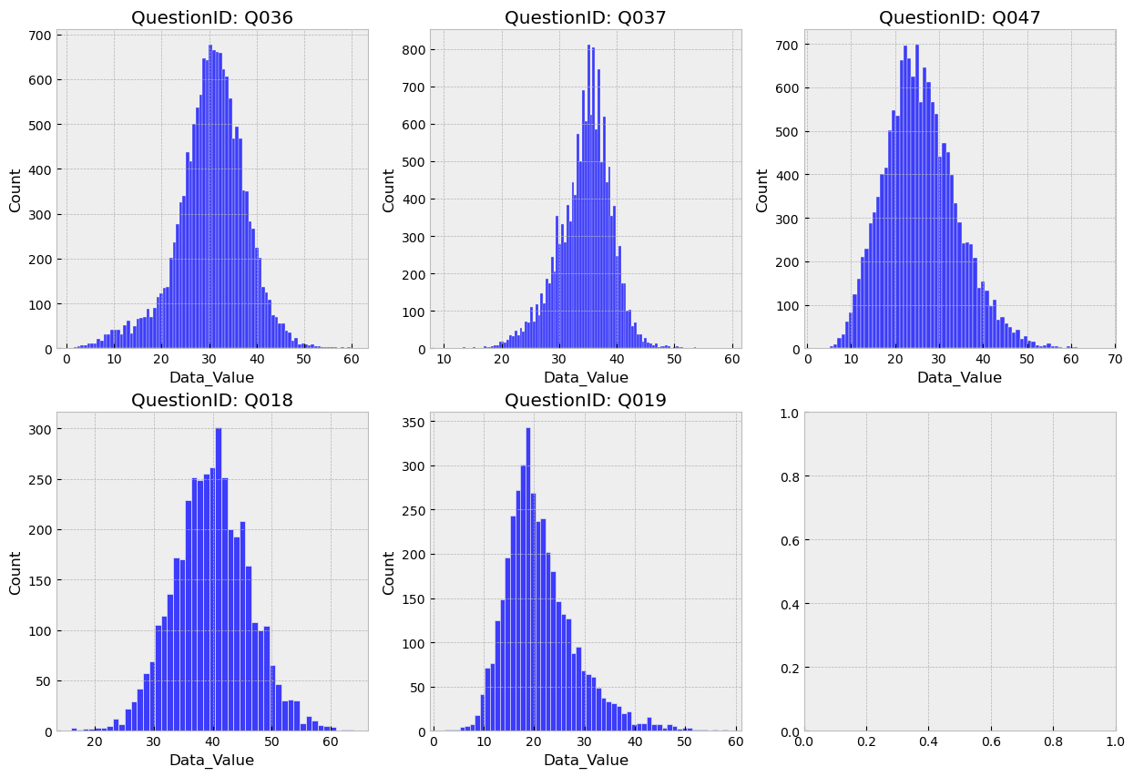
What is the distributions of Data Values across different Questions?
Inference:
Probably all the values about questions follow the normal distribution. For confirm this hypothese.
H0: the distribution are normal.

Slide 19
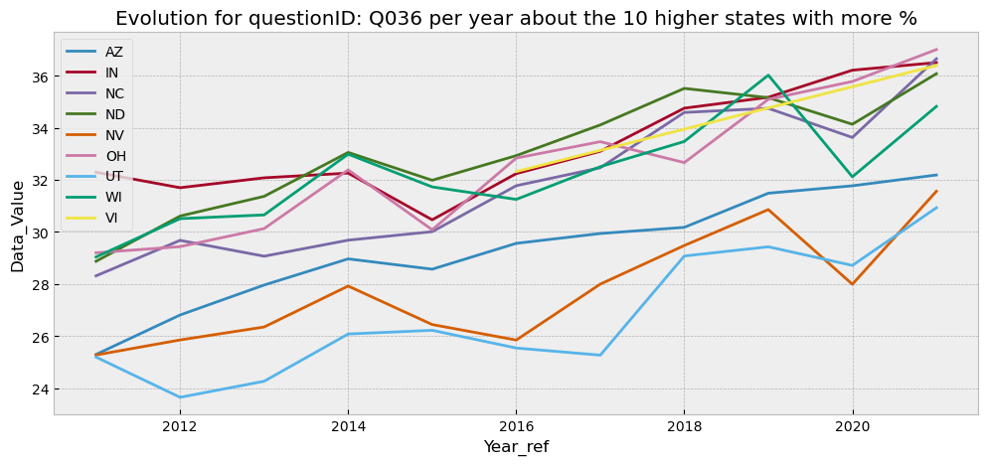
What is the percent obesity evolution by year per state?
Inference:
All states are in uptrend - About the data, by 2020 all states increase rates of obesity

Slide 20
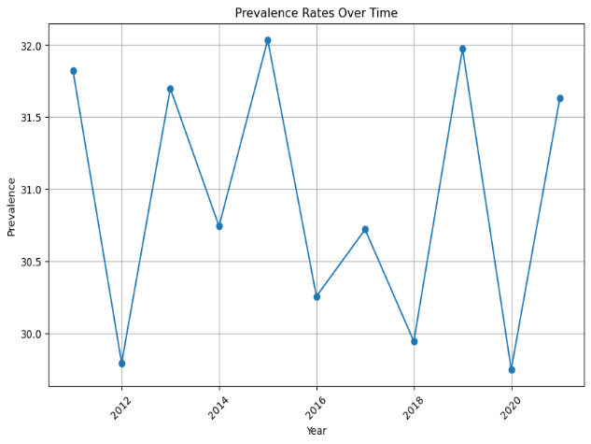
What is the Trend of Prevalence rates over time?
Inference: The overall trend of prevalence rates over time is decreasing. The change in prevalence rates over entire time period is: -0.191

Slide 21
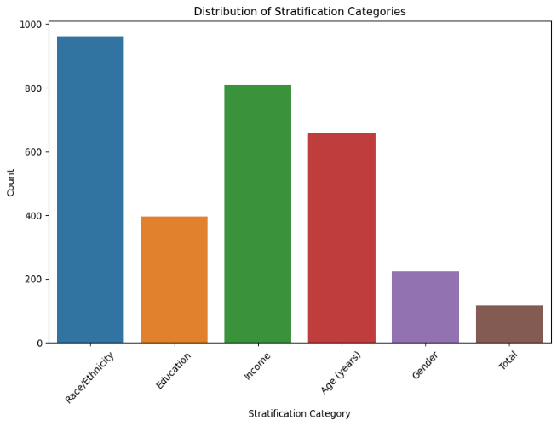
Which Stratification category has the highest count?
Inference: People grouped according to stratification category (Race/Ethnicity) show more prevalence rates.

Slide 22
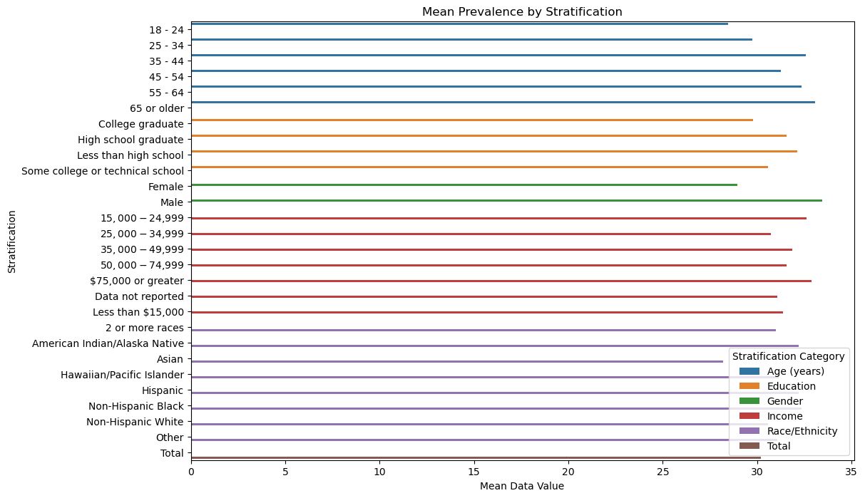
Among different stratifications which category has shown the highest mean prevalence rates?
Inference: People belonging to age group (65 or older) and people belonging to race (Hispanic) show more prevalence rates among different stratifications.

Slide 23
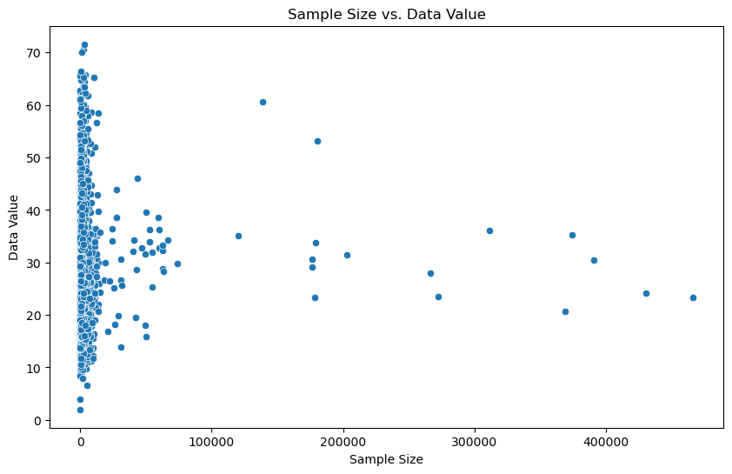
What is the correlation between chosen sample size and prevalence rates?
Inference: There exists a weak negative correlation of -0.0105 between sample size and prevalence rates.

Slide 24
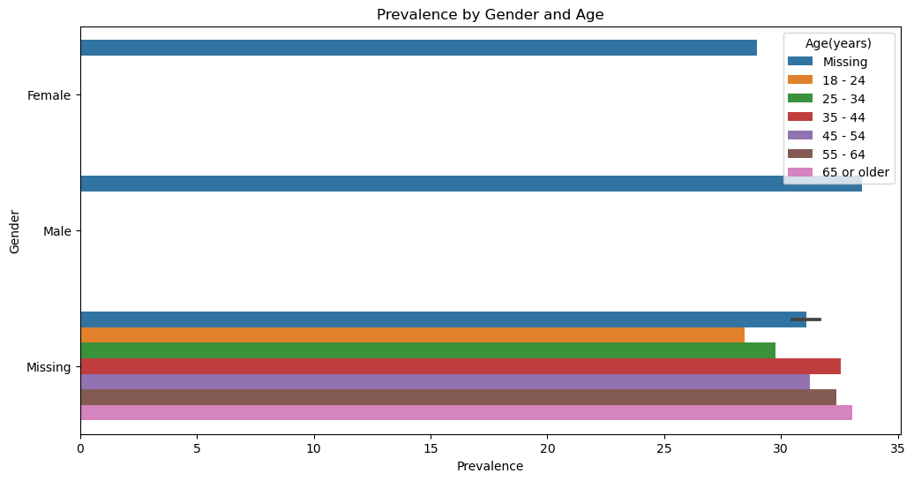
Prevalence rates according to gender and age.
Inference: Male population has higher prevalence rates compared to female population.

Slide 25
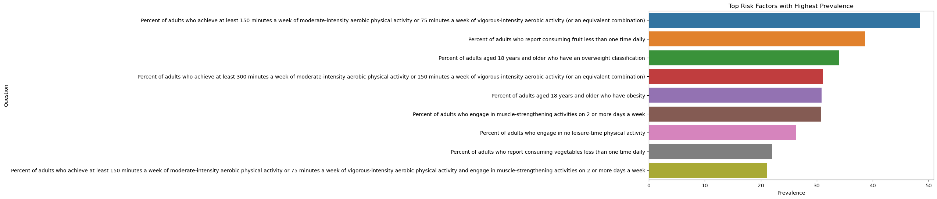
What are the top risk factors with respect to highest mean prevalence rates?
Inference: Among questions asked by the survey, top 3 questions showing higher mean prevalence rates can be considered as the risk factors.

Slide 26
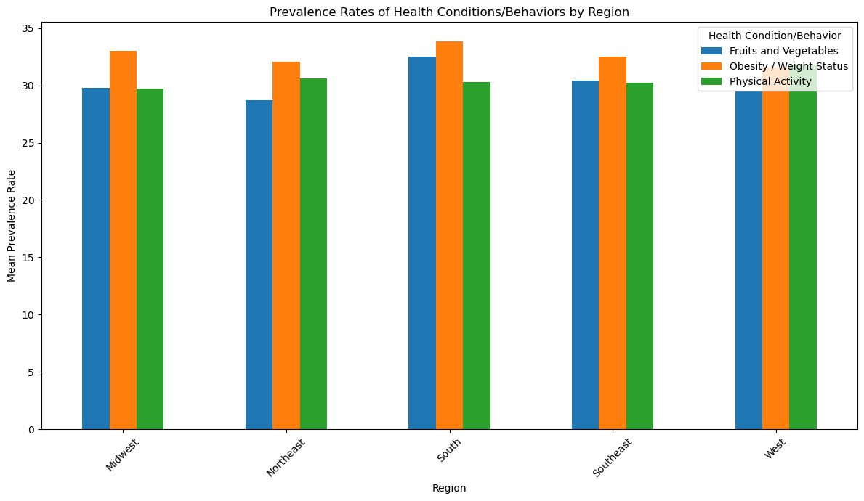
Overall Prevalence trends across different zones
Inference: We have divided different states of USA in to 5 zones, among which south zone show the highest mean prevalence rates.

Slide 27
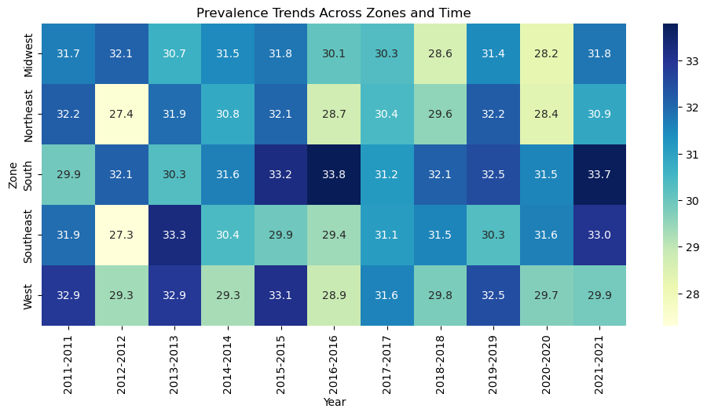
Prevalence Trends across different zones over time
Inference: The prevalence rates have kept on varying across different locations over time. The highest prevalence rate was 46.1% in Puerto Rico in the year 2021 and lowest prevalence rate was 15.5% in New Hampshire in the year 2012.

Slide 28
Conclusion
From the above analysis, we can conclude that people from 42 states in the US show obesity and weight status behavior. This certainly implies that the population of those states also lack physical activity. People of the remaining 8 states consume fruits and vegetables less than one time daily. There is no gradual increase or decrease in prevalence rates across different states over time. People belonging to the age group (more than 65) have the highest frequency of mean prevalence rates across different cities/states in the USA. Among stratification categories under Race/Ethnicity Hispanic people have highest prevalence rates and Asian people have lowest prevalence rates. The overall trend of prevalence rates over time is decreasing. The change in prevalence rates over the entire time period is: -0.191 which is negligible, hence we can conclude that the prevalence rates have remained constant over time.

Slide 29
Thank you

